Slide 1
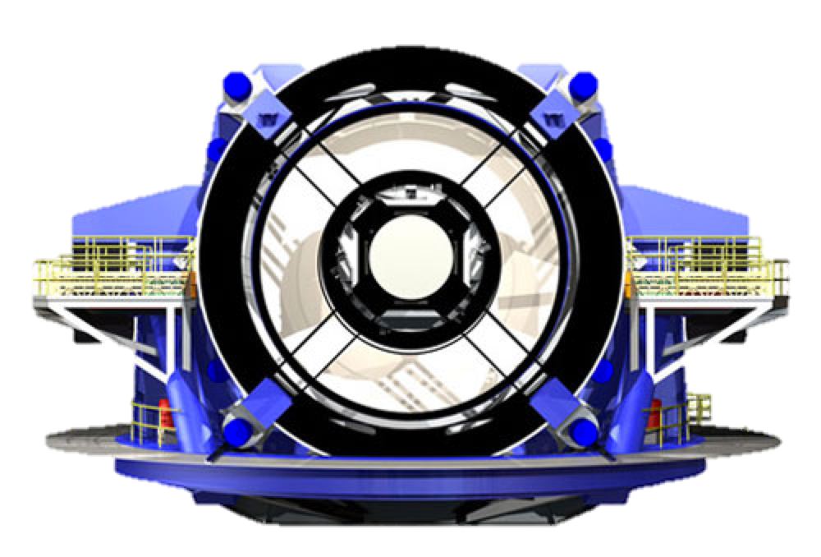

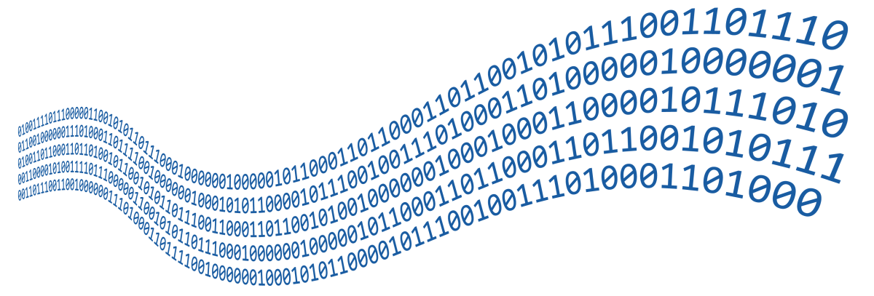


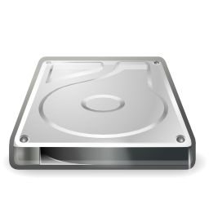

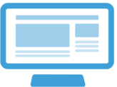

Portal
Notebook
Computing
Storage
Database
Software

Slide 2
Portal
Analysis
User Computing
User Storage
User Databases
Software
LSST Data Products

Slide 3
Portal
Notebooks
User Computing
User Storage
User Databases
Software
LSST Data Products

Slide 4

Portal
Notebooks
User Computing
User Storage
User Databases
Software
LSST Data Products: Images, Catalogs, Alerts

Slide 5
Portal
Notebooks
User Computing
User Storage
User Databases
Software
LSST Science Platform
LSST Data Products: Images, Catalogs, Alerts

Slide 6





Portal
Notebooks
User Computing
User Storage
User Databases
Software
LSST Science Platform
LSST Data Products: Images, Catalogs, Alerts

Slide 7
LSST Science Platform
Portal
Notebooks
User Databases
User Storage
User Computing
Software
LSST Data Products: Images, Catalogs, Alerts

Slide 8

LSST Science Platform
Portal
Notebooks
User Databases
User Storage
User Computing
TOOLS
LSST Data Products: Images, Catalogs, Alerts

Slide 9
LSST Science Platform
Portal
Notebooks
User Databases
User Files
User Computing
Software Tools
LSST Data Products: Images, Catalogs, Alerts

Slide 10

LSST Science Platform
Portal
Notebooks
User Databases
User Files
User Computing
Software Tools
LSST Data Products: Images, Catalogs, Alerts

